Slide 1

React JS Introduction -Renuka Bakshi

Slide 2
React is a popular JavaScript library used for building user interfaces in web applications. It was developed by Facebook and has quickly become a favorite among developers due to its simplicity, efficiency, and versatility.
Why React JS?
React's main focus is on the user interface, making it easier for developers to create interactive and dynamic web applications.
It allows you to build reusable UI components, which are like building blocks that can be combined to create complex UIs.
This component-based approach promotes code reusability and maintainability, saving you time and effort in the long run.

Slide 3
Key Features and Concepts :- 1. Virtual DOM 2. Declarative Syntax 3. Unidirectional Data Flow 4. React Components 5. State and Props

Slide 4
Some Popular Libraries and tools often used in conjunction in React JS:
Redux
React Router
Jest
Enzyme
Axious
Formilk
Material-UI
Storybook

Slide 5
Setting up the Development Environment in React JS
Setting up the development environment for ReactJS involves a few essential steps. Before you begin, ensure you have Node.js and npm (Node Package Manager) installed on your computer. If not, download and install them from the official Node.js website (https://nodejs.org).
Once you have Node.js and npm installed, follow these steps to set up the development environment for ReactJS:
Step 1: Create a React Project The easiest way to start a new React project is by using Create React App (CRA), an official tool from the React team. It sets up a modern development environment with all the necessary dependencies and build configurations. To create a new project using CRA, open your terminal or command prompt and run the following command:
npx create-react-app my-react-app

Slide 6
Replace my-react-app with your desired project name. This command will create a new folder with your project name and set up the React project inside it.
Step 2: Navigate to the Project Directory Navigate to your project directory using the cd command:
cd my-react-app
Step 3: Start the Development Server To run the development server and see your React app in the browser, execute the following command:
npm start

Slide 7
Folder Structure
my-react-app/
├── public/
│ ├── index.html
│ └── ...
├── src/
│ ├── components/
│ │ ├── Component1.js
│ │ ├── Component2.js
│ │ └── ...
│ ├── assets/
│ │ ├── images/
│ │ └── styles/
│ ├── App.js
│ ├── index.js
│ └── ...
├── package. Json
├── node modules/
└── ...

Slide 8
Explanation of the Folder Structure:
public/: This folder contains static assets that will be directly copied to the build folder during the build process. The index.html file is the main HTML template for your React application.
src/: This is the heart of your React application, where most of the development happens. It contains the source code for your React components, assets, and other necessary files.
src/components/: This folder holds all the individual React components that you create for your application. Organizing components into a separate folder helps to keep the project organized and maintainable.
src/assets/: This folder is used to store assets like images, fonts, and stylesheets that will be used in the application. Images are usually placed in the images/ sub-folder, and stylesheets are placed in the styles/ sub-folder.

Slide 9
src/App.js: This is the main component of your React application. It serves as the entry point of your app and typically includes the navigation and layout structure.
src/index.js: This file is the entry point of your application. It is responsible for rendering the main component (App.js) and injecting it into the index.html file in the public/ folder.
package. Json: The package. Json file is a JSON file that holds the metadata of your project, including its dependencies, scripts, and other configurations.
node modules/: This folder contains all the third-party dependencies that your project needs. These dependencies are automatically installed when you run npm install.

Slide 10
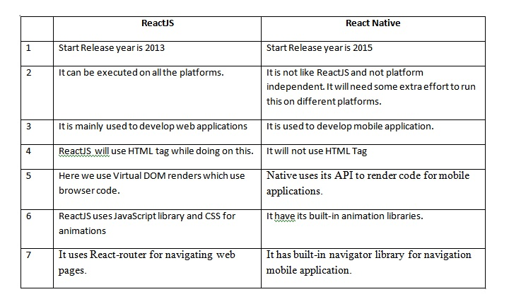
ReactJS and React Native: Understanding the Differences

Slide 11
Interview Questions
1. What are the essential tools and technologies needed to setup a Resact.js development environment?
2. How do you install Node.js and npm , why are they important for React development?
3. What is the saignificance of the package.json file in a React project?
4. What are the features and concepts of React JS?

Slide 12
Features of React js
1- Virtual DOM
2- Component Based Architecture
3- JSX
4- Unidirectional Data flow

Slide 13
Pro of React js
Reusability and Maintainability-
High Performance
Strong community and Ecosystem
Rich Developer Tools

Slide 14
Cons of React js
1- Learning curve-
2- Tooling complexity
3- frequent update
4- Large file size

Slide 15
Aspect | React.js | Angular
Language | JavaScript, JSX (optional) | TypeScript (optional)
Learning Curve | Relatively easier to learn | Steeper learning curve
Community & Ecosystem | Large and active community | Large and well-established community
Data Binding | One-way data binding (unidirectional) | Two-way data binding (using ngModel)
Templating | JSX (JavaScript XML) | HTML with additional Angular directives
State Management | External libraries (e.g., Redux, MobX) | Built-in services (e.g., RxJS, NgRx)
Routing | React Router | Built-in router module
Forms Handling | Controlled components (uncontrolled also) | Template-driven and Reactive forms
Directives | Custom and third-party directives | Custom and built-in directives
Mobile Support | React Native for mobile app development | Ionic framework provides mobile support
Performance | Efficient Virtual DOM for updates | Good performance with aggressive change detection
Component Reusability | High, with a functional component approach | High, with well-defined component lifecycle
Tooling & CLI | Create React App (CRA) and other tools | Powerful CLI (Angular CLI)
DOM Manipulation | Virtual DOM with diffing algorithm | Direct DOM manipulation (declarative approach)
Use Cases | Single-page applications, UI-focused | Large-scale applications, enterprise projects

Slide 16
Thank You !!

